Slide 1
Find A Group
Helping users join groups and events.
By: David Rose, Cameron Brien, Nicholas Hansen, Jackson Turner, and
Darian Colon
Tuesday Group 2

Slide 2
Video Link
https://drive.google.com/open?id=1GB6-PzNJBMlt0yIpji-ruoP0sNzcfCbM

Slide 3
Summary
As a team, we used the classic waterfall model to build and deliver our software.
Text files were used to store a specific user’s data for later use. They were also used to save time during the development process.
We used the Intellij IDE to write our source code and used SceneBuilder to design the GUI layout.
After extensive testing, we have found a small oversight: if a group leader attempts to add a meeting without selecting a group, an unhandled null pointer raises.

Slide 4
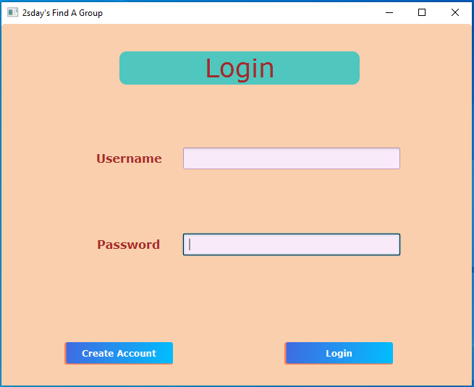

Slide 5
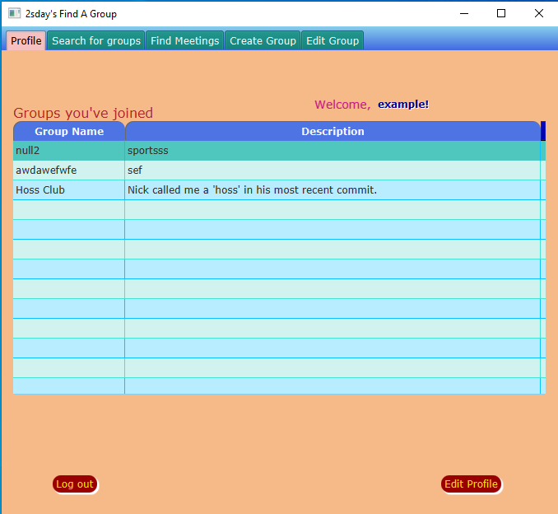

Slide 6
Questions
Are there any questions?

Slide 7
Thank You

